Slide 1
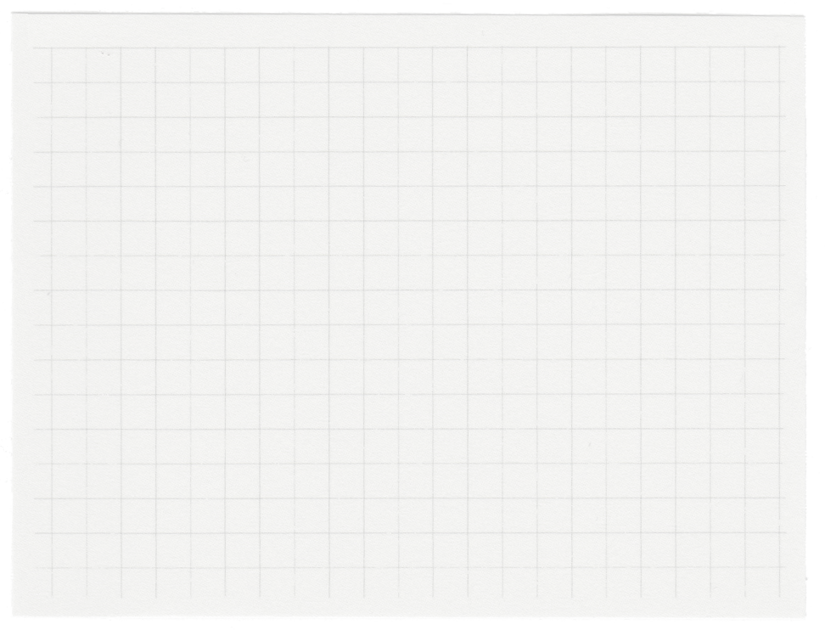













Graph algorithms
Presented by Group 15
Nguyễn Nguyên Khang - 22520623
Đỗ Phương Duy - 23520362

Slide 2
What is a graph?
Notes:
Theo bạn đồ thị là gì?

Slide 3
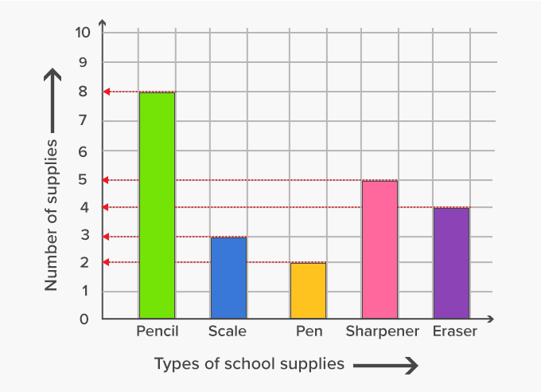
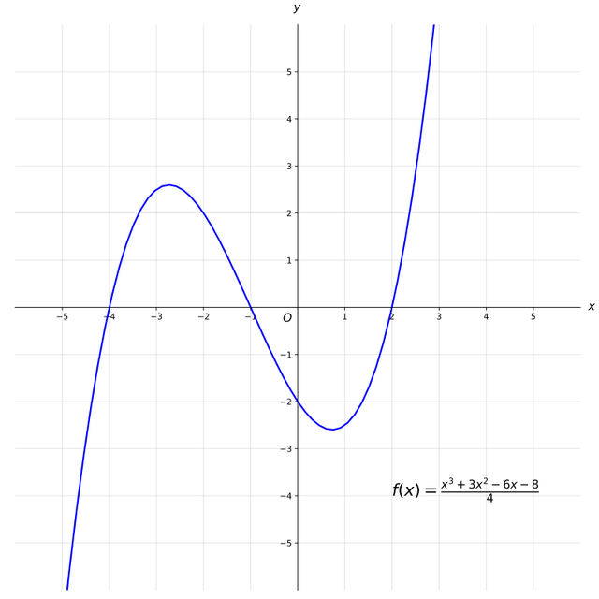
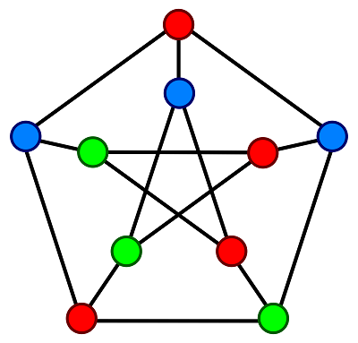
Is this a graph?

Slide 4
What is a graph?
A graph (in graph theory) is a data structure that represents relationships between entities, where nodes represent entities and edges represent their connections.

Slide 5
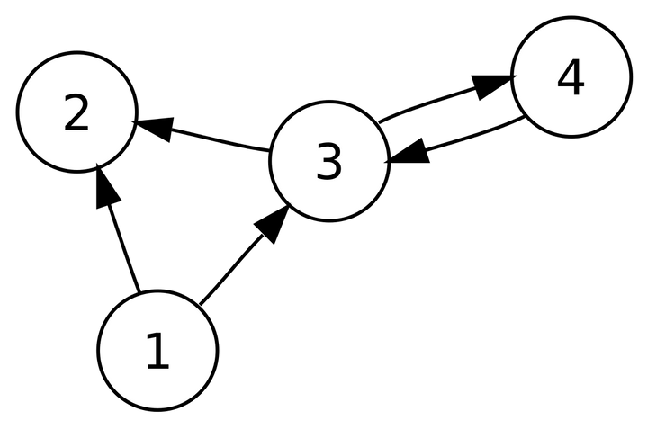
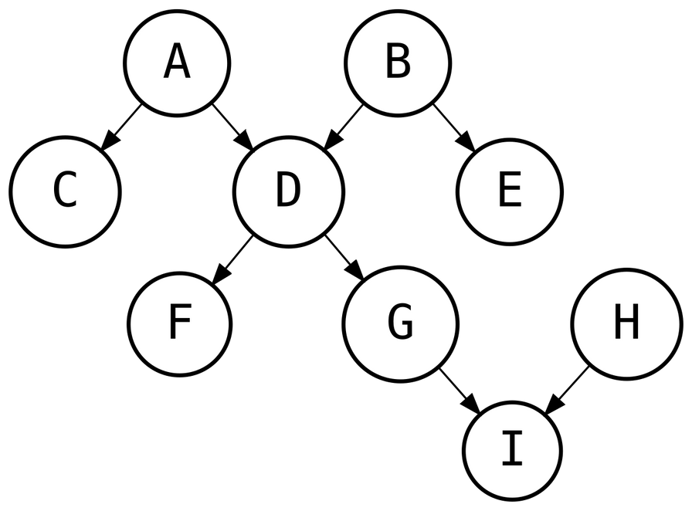
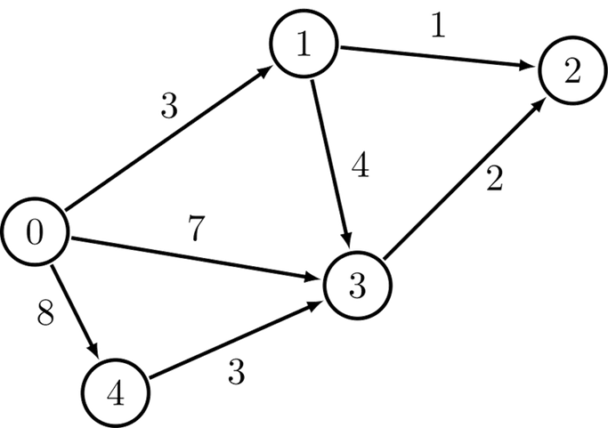
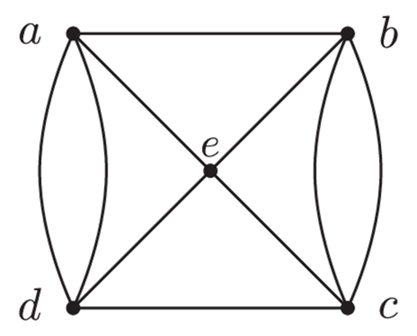
Popular types of graph?
Undirected/Directed graph
Unweighted/Weighted graph
Acyclic/Cyclic graph
Single/Multi graph
Unconnected/Connected graph
...
Notes:
Câu hỏi: Bạn có thể kể một số dạng đồ thị đã học

Slide 6
When can we use graph algorithms??
Relationships or Connections between Entities
Problems like Optimization of Flows or Resource Allocation: Optimizing routes, costs or resource distribution...
Structural Analysis and Partitioning: Identifying important nodes, or graphs partitioning...
Notes:
Bạn nghĩ dạng vấn đề nào trong cuộc sống có thể được trừu tượng hóa thành dạng đồ thị?
Đồ thị trong networking (xây dựng mạng lưới quan hệ)?

Slide 7
What are some applications of graph structure?

Slide 8
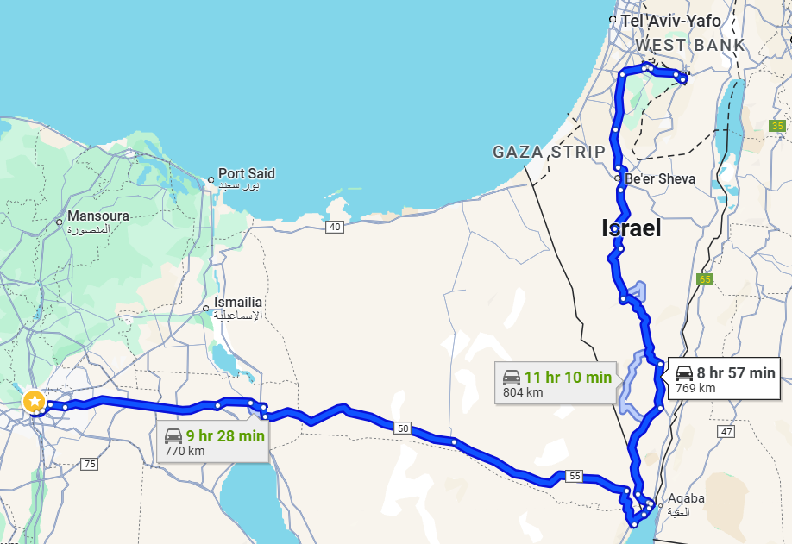
Graph in real life
Path finding for travelling: Finding the shortest or optimal travel paths
Notes:
Khi bạn tới 1 nơi xa lạ bạn không rành đường, bạn sẽ làm gì:
- Dùng google map: đã ứng dụng graph algorithms
- Hỏi dân địa phương: abstract bài toán (node thứ nhất là bạn, node thứ 2 là người dân, node thứ 3 là thông tin, node đích là điểm đến cần tìm)

Slide 9
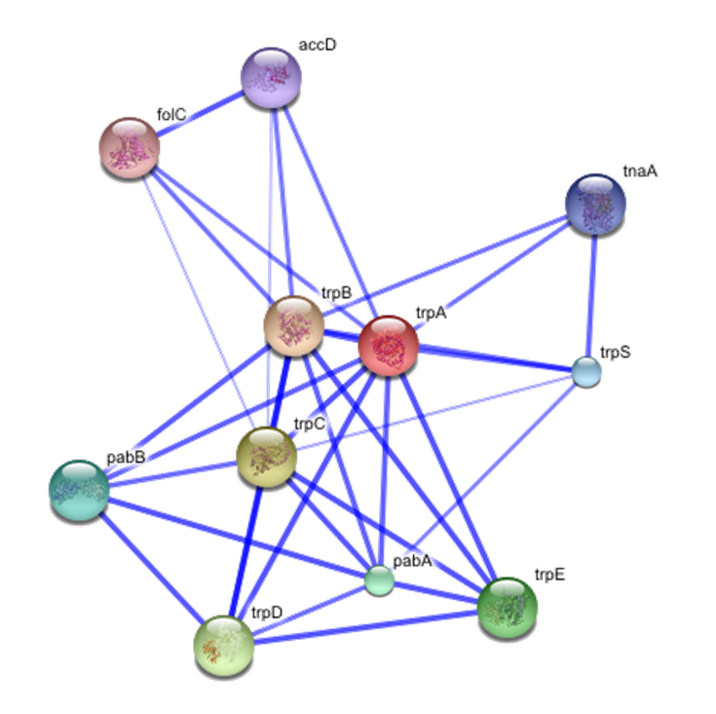
Graph in real life
String databases: Representing protein interactions or biological data using graph-based structures

Slide 10
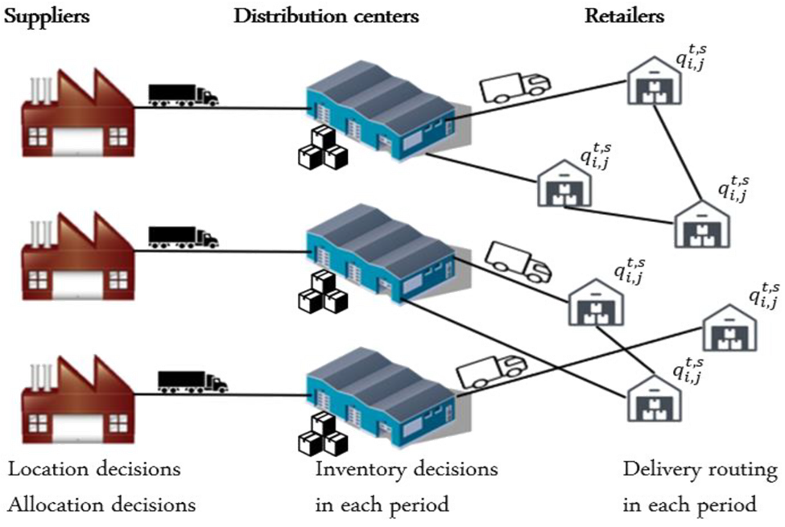
Graph in real life
Supply Chain and Logistic Networks: Optimizing routes, minimizing costs, and ensuring timely deliveries in a network
Notes:
bạn có thể abstract chuỗi cung ứng như thế nào

Slide 11
Graph algorithms design step by step
Step 1: Problem definition: Identify the goal. Abstract the problem. Determine the relevant entities and their relationships.
Step 2: Graph representation: Choose the right format.
Step 3: Select and implement an appropriate Algorithm.
Step 4: Testing, Validating and Complexity Analysis.

Slide 12
If you had to name only one algorithm, which would you consider the most common for finding the shortest path???

Slide 13
Are there cases where Dijkstra's algorithm is not a good idea??

Slide 14
Scenarios where Dijkstra is not suitable
When the Goal is Unclear or Search Space is too Large
Limited Memory or Computational Resources
When Optimality is Not Required
Uninformed Search Requirements

Slide 15
Problem 1: Uninformed search

Slide 16
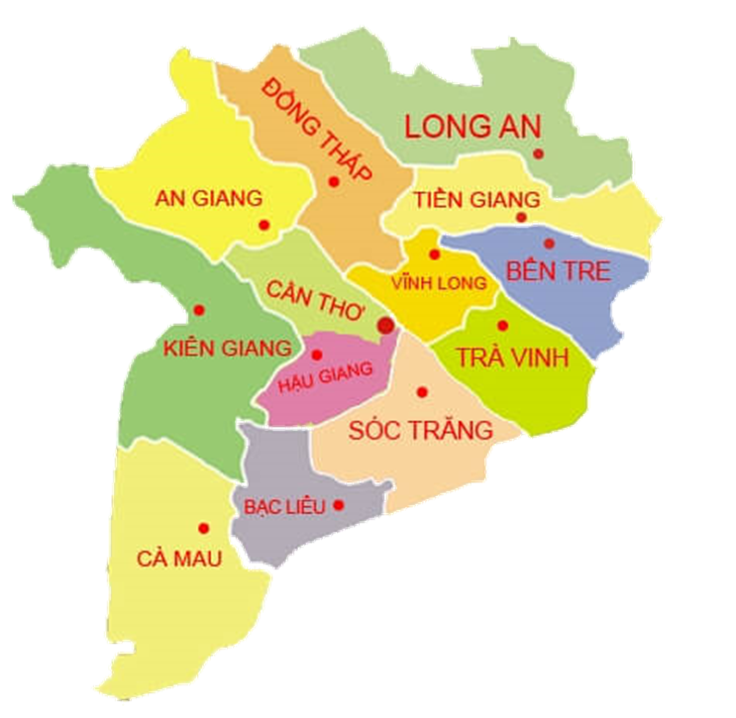
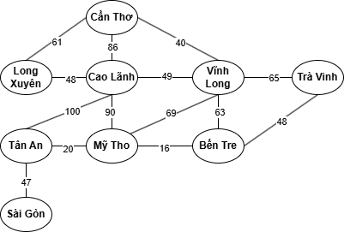
Traveling in Mekong River delta
Lets find a way from Cần Thơ to Sài Gòn

Slide 17
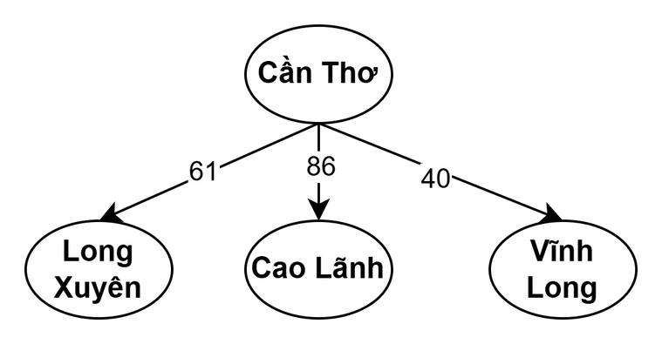

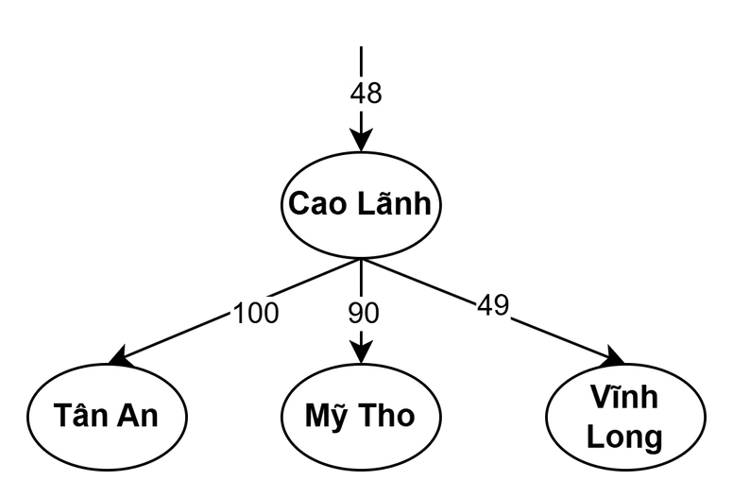
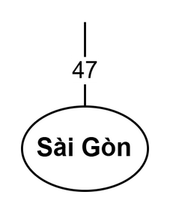
Uninformed Search - DFS
Explores as deep as possible down each branch before backtracking.
Total distance:
61 + 48 + 100 + 47 = 256
Notes:
Yêu cầu 1 bạn nhắc lại thuật toán DFS
Yêu cầu 1 bạn nhắc lại thuật toán BFS

Slide 18
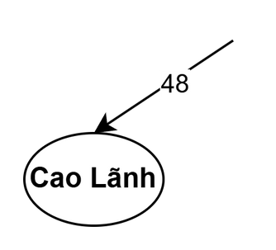
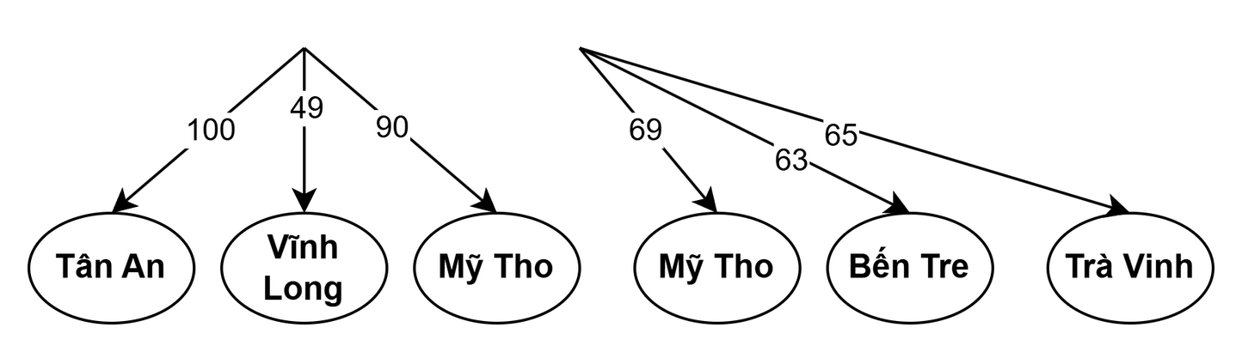
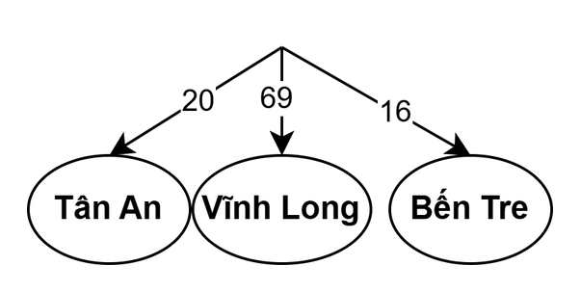
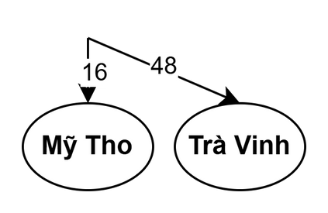
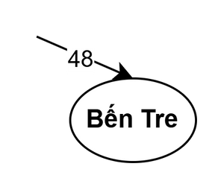
Uninformed Search - BFS
Explores level by level
Total distance:
86 + 100 + 47 = 233

Slide 19
Uninformed Search - BFS
Explores level by level
Is BFS optimal???
-> Only if graph is unweighted
As it returns the path with the least number of steps

Slide 20
Can DFS and BFS be considered brute-force approaches???

Slide 21
In this problem: Yes, as they explore all vertices and edges without optimization and guidance.
Examples of cases where they are not:
DFS: Topological sorting in Directed Acyclic Graphs: efficiently orders the vertices without blindly exploring all possible paths
BFS: Shortest path in Unweighted Graph: Explore the graph level by level, ensuring the shortest path without needing to check all possible paths.

Slide 22
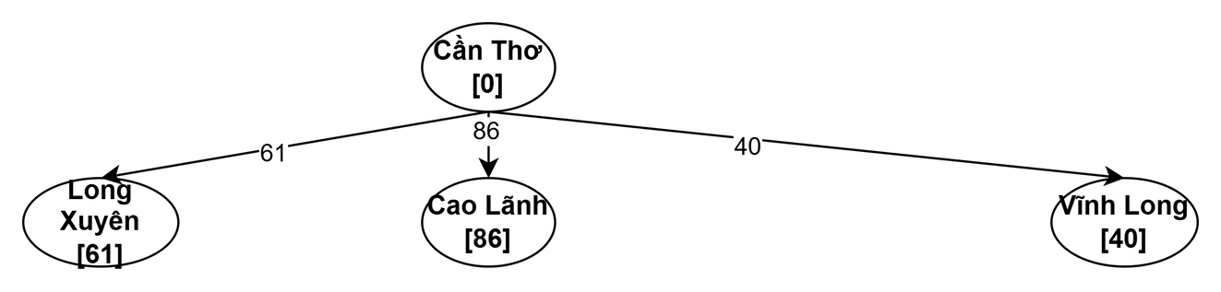
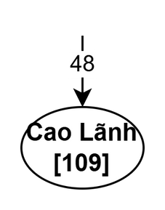
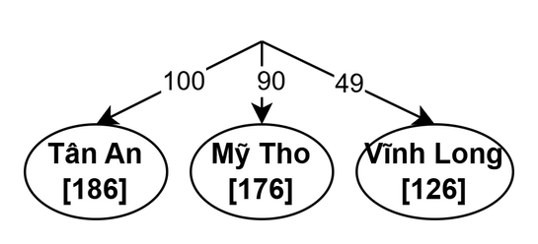
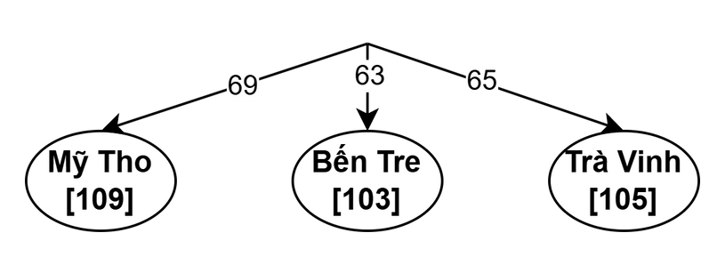
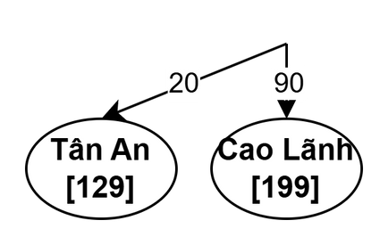
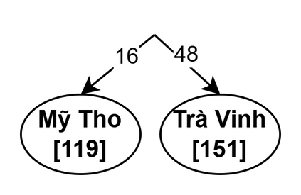
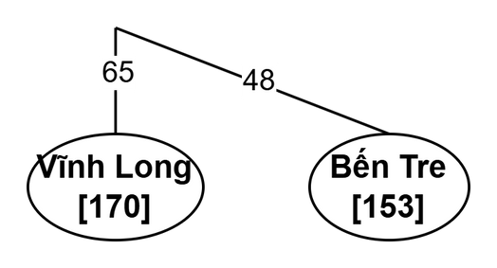
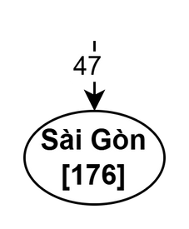
Uninformed Search - UCS
Expands the least-cost node first
Total distance:
40 + 69 + 20 + 47 = 176

Slide 23
Uninformed Search - UCS
Expands the least-cost node first
Is UCS optimal???
-> Yes ! Proof in A*

Slide 24
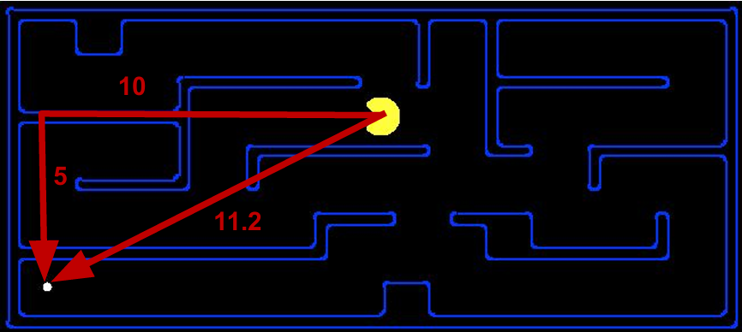
Search Heuristics
An heuristic is:
A function that estimates how close a state is to a goal
Designed for a particular search problem
Examples: Euclidean distance, Manhattan distance,...
Notes:
Kể tên vài độ đo phổ biến mà bạn biết

Slide 25
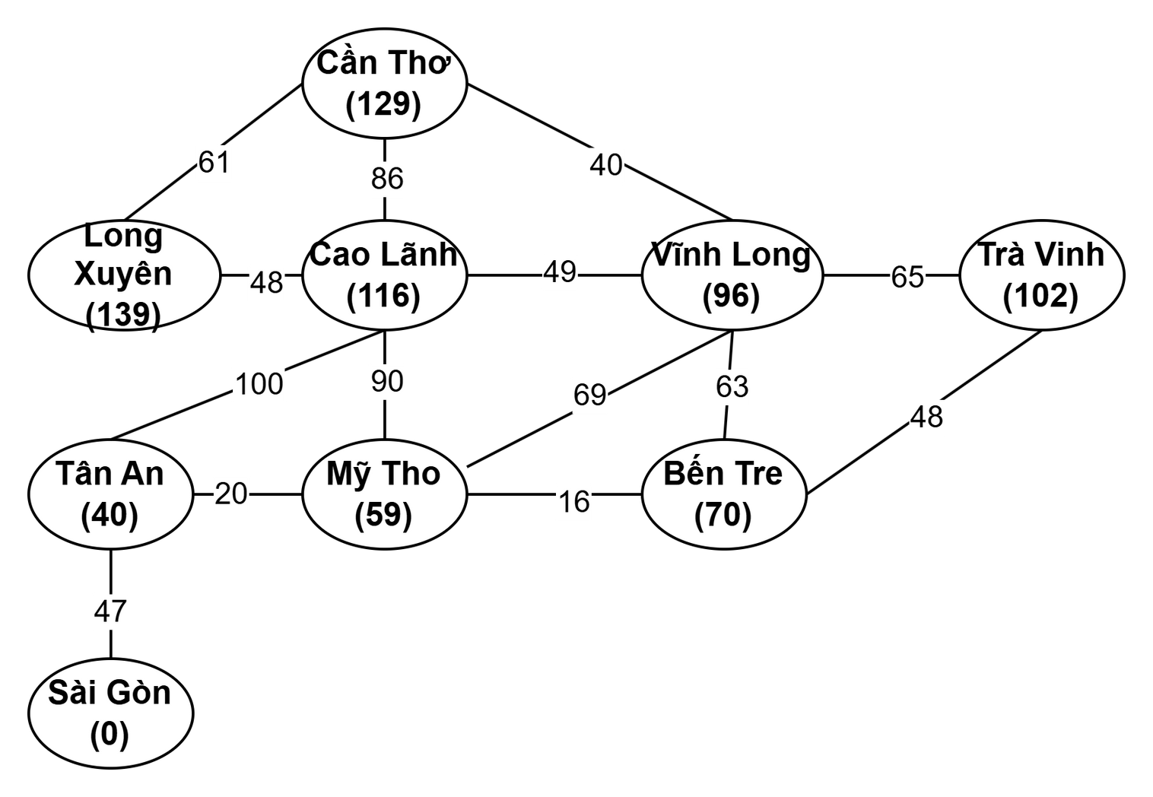
H(x) = straight line distance to
Sài Gòn
Lets find a way from Cần Thơ
to Sài Gòn again!

Slide 26
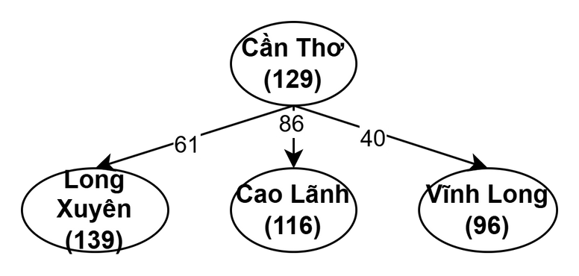
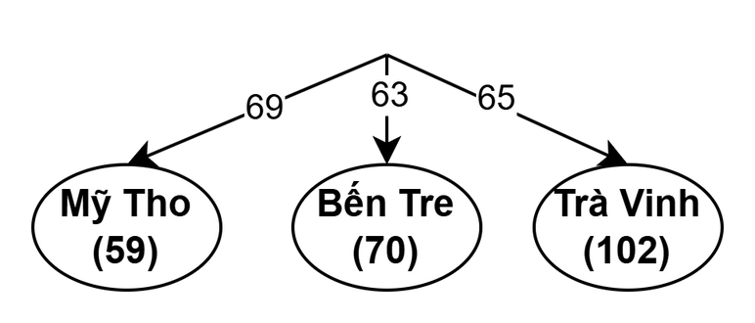
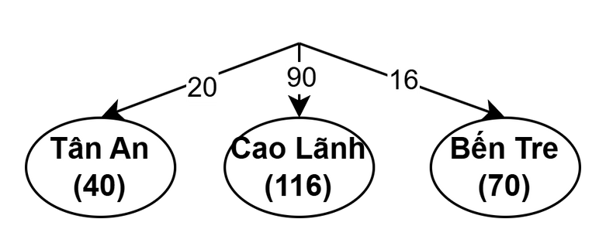
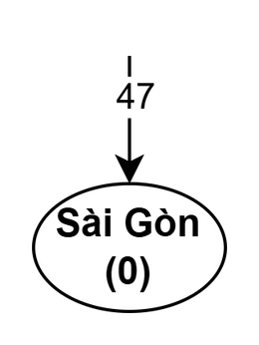
Informed Search - Greedy
Expands the node closest to the goal based on a heuristic
Total distance:
40 + 69 + 20 + 47 = 176

Slide 27
Informed Search - Greedy
Expands the node closest to the goal based on a heuristic
Is Greedy optimal???
-> No ! Since it depends heavily
on the quality of the heuristic function
Notes:
bạn nghĩ greedy có tối ưu không
sao kết quả trên slide nó tối ưu mà
nếu xài hàm heuristics khác thì có đảm bảo tối ưu không

Slide 28
Informed Search - Greedy
Expands the node closest to the goal based on a heuristic
Is there a good way to leverage the heuristic function without blindly following its values???

Slide 29
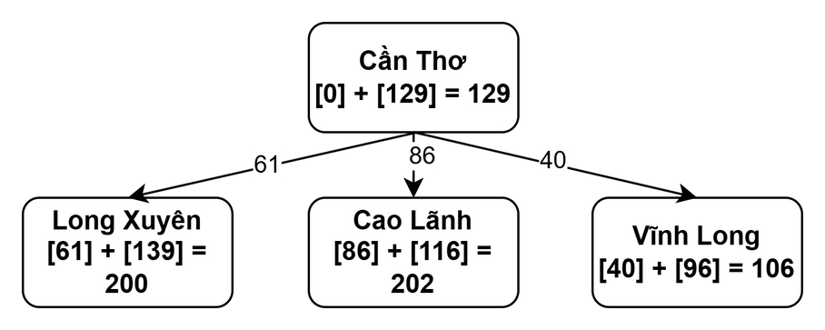
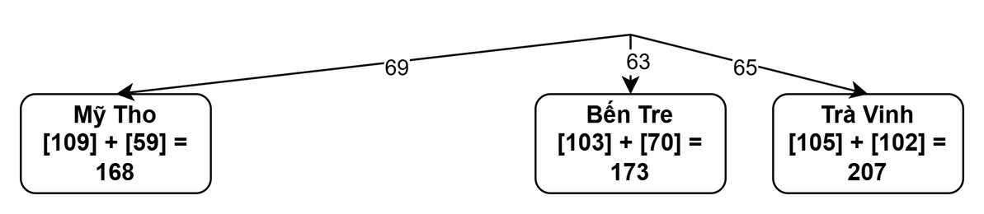
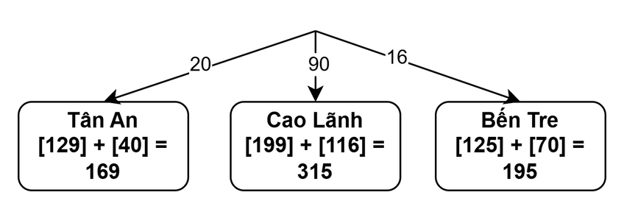
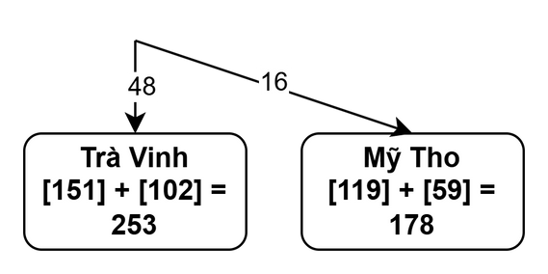
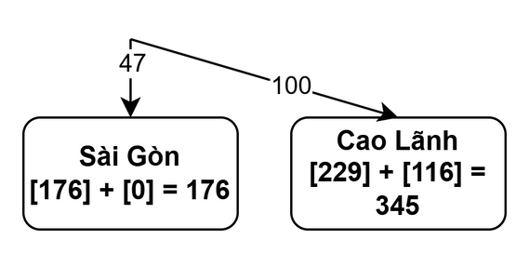
Informed Search - A*
Combines UCS and Greedy by considering both path cost and heuristic
Total distance:
40 + 69 + 20 + 47 = 176

Slide 30
Informed Search - A*
Combines UCS and Greedy by considering both path cost and heuristic
Is A* optimal???

Slide 31
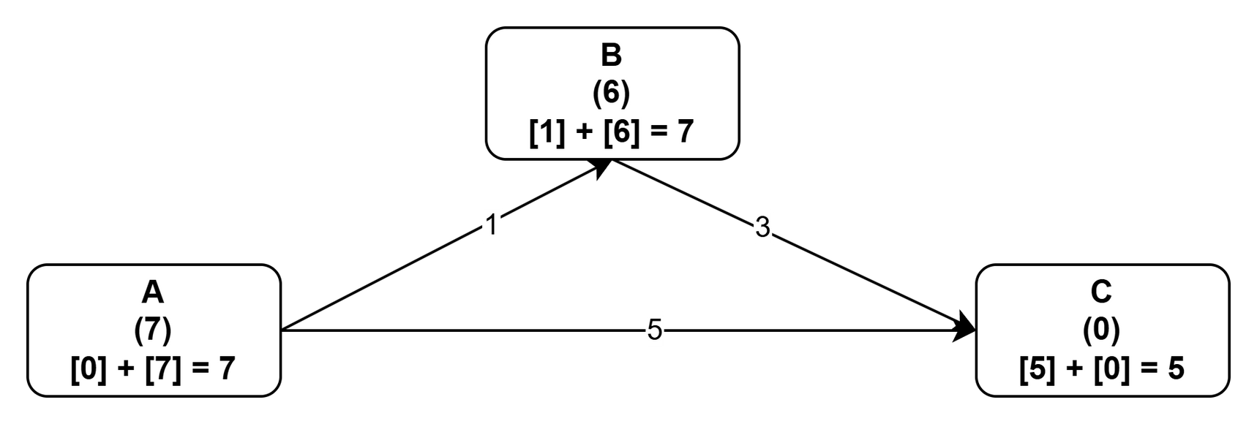
What went wrong?
We need estimates to be less than or equal to the actual costs!
Notes:
bạn thấy đường nào ngắn hơn
bạn nghĩ thuật toán A* sẽ đi đường nào

Slide 32
Admissibility
and Consistency
A heuristic h is admissible (optimistic) if:
0 ≤ h(n) ≤ h*(n)
where h*(n) is the true cost to the nearest goal
A heuristic h is consistency if:
h(A) - h(C) ≤ cost(A to C)
value along a path never decrease

Slide 33
Optimality of A*
Tree search:
A* is optimal if heuristic is admissible
UCS is a special case (h = 0)
Graph search:
A* is optimal if heuristic is consistent
UCS optimal (h = 0 is consistent)

Slide 34
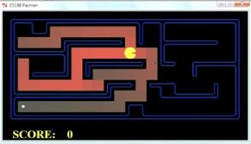

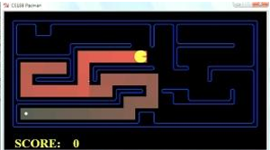
Comparison
A*
UCS
Greedy

Slide 35



Comparison
Greedy
UCS
A*

Slide 36
Problem 2: Multisource
shortest path

Slide 37
Multisource shortest path
The Multisource Shortest Path Problem finds the shortest paths from multiple source nodes to all other nodes in a graph. It extends single-source methods by starting from multiple origins simultaneously.

Slide 38
Multisource shortest path
Why bother
multisource scenarios???

Slide 39
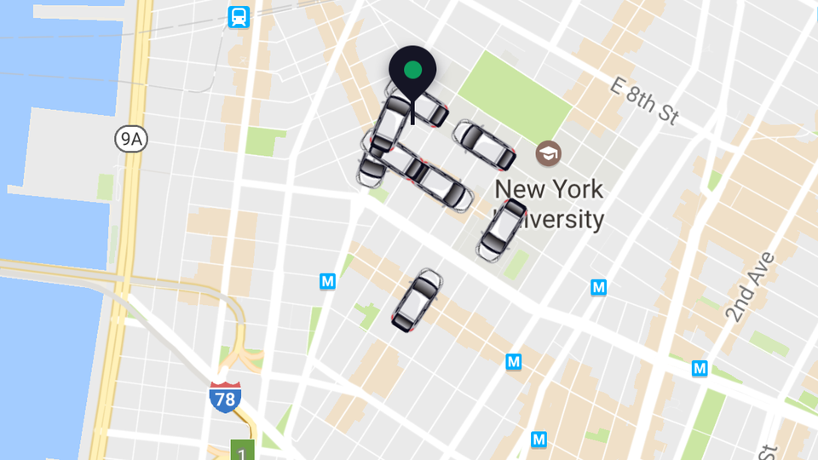

Real applications
Driver-Passenger Connections: services like Grab and Uber, the multi-sources shortest path problem optimizes routes between multiple passengers and drivers, minimizing wait times and travel distances.

Slide 40
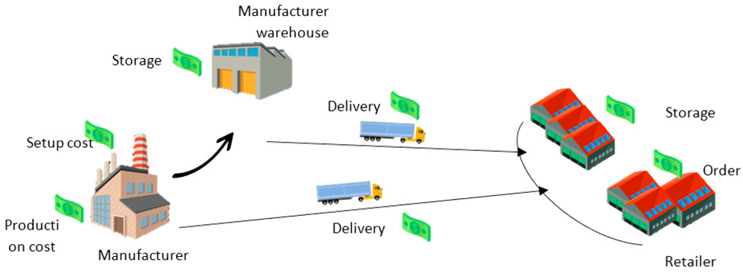
Real applications
Warehouse and Delivery Optimization: optimizes routes within warehouses and delivery networks by calculating efficient paths for workers and vehicles from various starting points to multiple destinations. Improving operational efficiency.

Slide 41
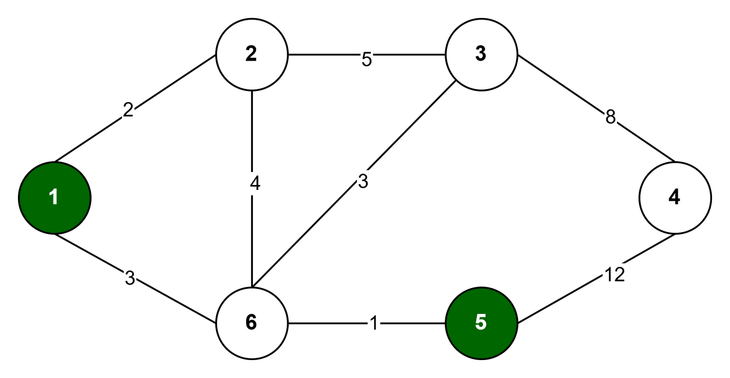
Multisource shortest path
Suppose there are n towns connected by m bidirectional roads. Each road's weight represents the travel time between two towns. The goal is to find the minimum travel time from the nearest police station for each town, with a cost of 0 for towns that have a police station.
Notes:
Bạn nghĩ cách đơn giản nhất để giải bài này là gì

Slide 42
Is BFS a good idea?

Slide 43
Multisource BFS
Key idea: Starting from all the towns with police stations simultaneously, BFS finds the shortest distance to all other towns.

Slide 44
Multisource BFS
Step:
1. Create a queue with all towns having police stations. Set their distances to 0
2. Multisource BFS:
Dequeue a town and check its neighbors
If a neighbors has not been visited, update its distance as the current towns distance + vertex and enqueue it
3. Continue until all reachable towns are visited
Complexity:
Time: O(V + E)
Space: O(V + E)

Slide 45
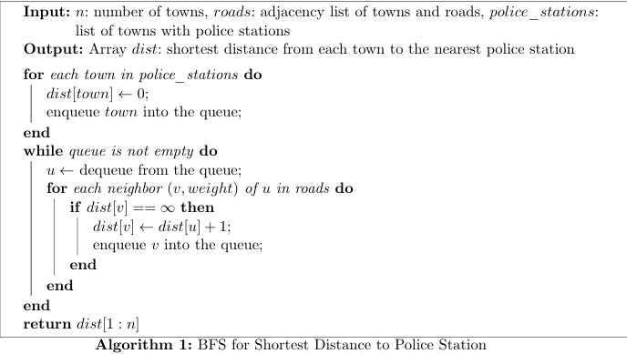
Multisource BFS

Slide 46
Multisource BFS
Is BFS optimal???
-> Only if the graph is unweighted
As it returns the path with the least number of steps

Slide 47
Is Dijkstra a good idea?

Slide 48
All-Pairs Dijkstra
Key idea: Treat towns with police stations as a virtual source; use a priority queue to compute shortest paths.

Slide 49
All-Pairs Dijkstra
Step:
1. Treat all towns with police stations as a virtual source. Add a virtual node and connect it to every police station with an edge weight of 0.
2. Run Dijkstra from virtual sources:
Use a priority queue to repeatedly extract the node with the smallest current distance
For each neighbor, update its distance if a shorter path is found.
3. Remove the virtual source after processing
Complexity:
Time: O((V + E).logV)
Space: O(V + E)

Slide 50
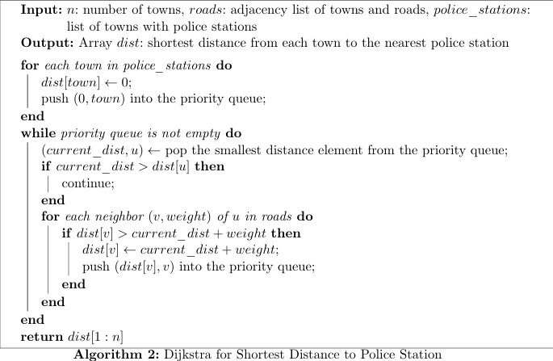
All-Pairs Dijkstra

Slide 51
Which algorithm design technique does Dijkstra's algorithm use?
Answer: Greedy
It makes locally optimal choices at each step such as selecting the currently known shortest path to a vertex, with the hope that these choices lead to a globally optimal solution
Optimal substructure: shortest path from the source to any vertex v must include the shortest path to every intermediate vertex u along that path.

Slide 52
Is Dynamic Programming possible?

Slide 53
Floyd-Warshall algorithm
Key idea: Compute shortest paths between all pairs of towns using dynamic programming.

Slide 54
Floyd-Warshall algorithm
Step:
1. Initialize a nxn distance matrix:
Set dist[i][j] to the road weight, dist[i][i]=0
2. Floyd-Warshall algorithm:
For each town k, update all pairs (i, j):
dist[i][j] = min(dist[i][j], dist[i][k]+ dist[k][j])
Complexity:
Time: O(V³)
Space: O(V²)

Slide 55
Floyd-Warshall algorithm
Floyd-Warshall is a dynamic programming approach!
Optimal Substructure: The shortest path from i to j can be built by combining the shortest paths from i to k and from k to j
dist[i][j] = min(dist[i][j], dist[i][k]+ dist[k][j])
Overlapping Subproblems: Shortest paths with up to k intermediate vertices are computed and reused to find paths with k+1 intermediate vertices.

Slide 56
Is there any case where Floyd-Warshall outperforms Dijkstra in terms of time cost???

Slide 57
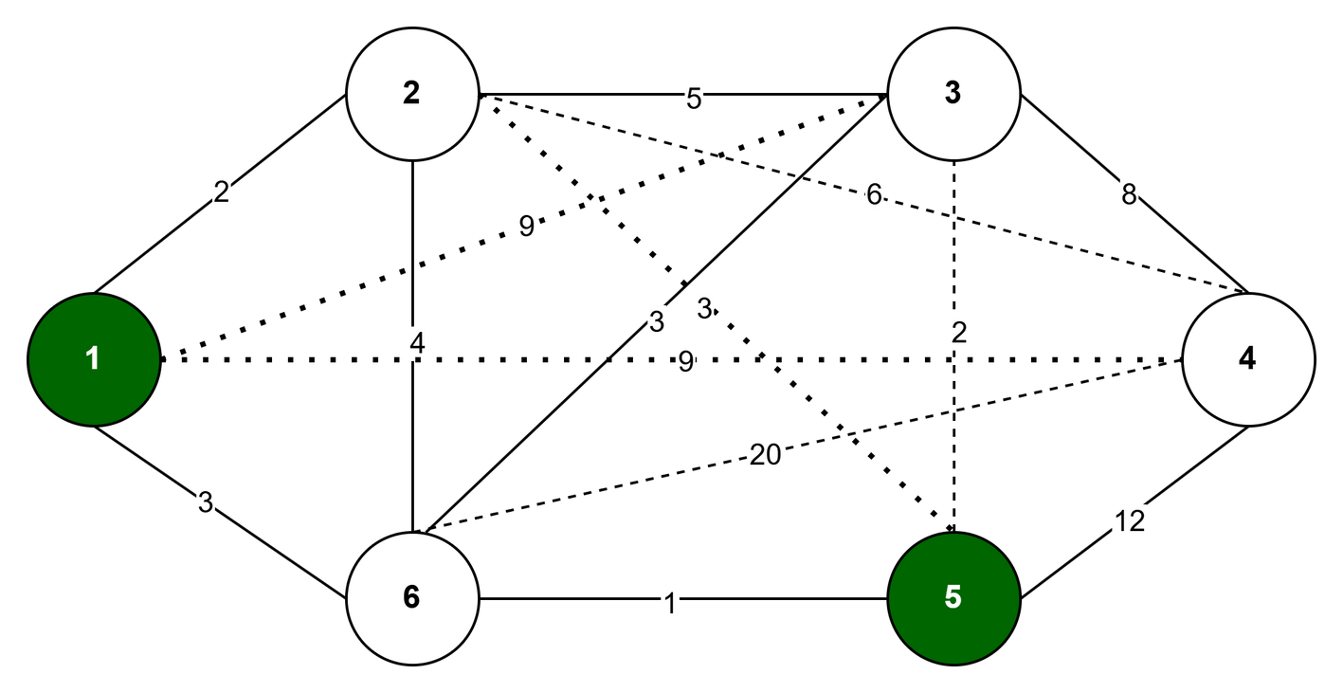
Let’s consider this graph

Slide 58
Floyd-Warshall is more suitable on small but dense graphs
Time complexity: O(V³) where V is the number of vertices, this complexity is independent of the number of edges making it particularly effective for dense graphs.
Efficiency: It computes all-pairs shortest paths in one execution, avoiding the repeated runs required by single-source shortest-path algorithms.

Slide 59
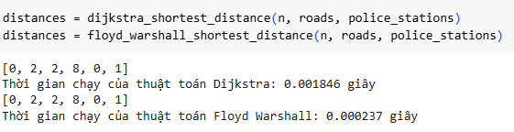
Running results in the following graph

Slide 60

Floyd-Warshall algorithm

Slide 61

Let’s take a look at this scenario
Some towns have successfully implemented time-travel technology, which enable the use of time-travel routes that reduce travel time or even save time by going back in time, represented as edges with negative weights.

Slide 62
How can we find optimal paths in this scenarios???

Slide 63
Bellman-Ford algorithm
Key idea: Iteratively relaxes all edges V - 1 times to compute the shortest distances from source nodes to all other nodes.

Slide 64
How can Bellman-Ford tackle roads with negative weights???

Slide 65
Bellman-Ford algorithm
Relaxation Technique: If a path through the edge (u, v) with weight w offers a lower cost than the current cost stored in dist[v], then update dist[v]=dist[u] + w, making the algorithm flexible enough to handle both positive and negative weights.
Final pass: After V-1 iterations, an extra relaxation is performed to find possible negative-weight cycle indicating an infeasible solution

Slide 66
Bellman-Ford algorithm
Bellman-Ford uses ideas from dynamic programming!
Optimal Substructure: The shortest path from the source to any vertex v can be constructed by combining the shortest path from the source to a predecessor u of v with the edge (u, v).
Overlapping Subproblems: The algorithm computes solutions to subproblems (shortest paths involving k edges) and reuses them to build the solution for paths involving k+1 edges

Slide 67
Bellman-Ford algorithm
Step:
1. Create a distance array “dist” of size V, all values are initially set to infinity except source nodes.
2. Relaxation:
For each edge (u, v) with weight w:
dist[v] = min(dist[v], dist[u] + w)
dist[u] = min(dist[u], dist[v] + w)
3. Perform the relaxation step V-1 times
4. Negative weight cycle detection:
Perform one more relaxation. If any distance updates, a negative weight cycle exists, indicating an infeasible solution.
Complexity:
Time: O((V.E))
Space: O(V+E)

Slide 68

Bellman-Ford algorithm

Slide 69
Link to implemented code
https://colab.research.google.com/drive/1Pvgzds65BZp_C2ow98dZE9vUvc30BiIE?usp=drive_link

Slide 70
Comparison
Algorithm | Key idea | Complexity | Best used for
BFS | Explores neighbors level-by-level | O(V + E) | Unweighted graphs, large sparse graphs
Dijkstra | Uses a priority queue for shortest paths in weighted graphs | O((V + E)logV) | Weighted graphs, large sparse graphs
Bellman-Ford | Computes all-pairs shortest paths | O(V.E) | Graphs with negative weights or when other algorithms like Dijkstra cannot be applied
Floyd-Warshall | Relaxes edges repeatedly; handles negative weights | O(V³) | Dense graphs, small graph sizes

Slide 71

QUIZ!

